Slide 1



API part 3
Integrative Programming

Slide 2



Outline
Create authentication using JWT
www.its.ac.id
INSTITUT TEKNOLOGI SEPULUH NOPEMBER, Surabaya - Indonesia

Slide 3
JWT
JWT is JSON Web Tokens
JWT is an open standard that defines a compact and self-contained way for securely transmitting information between parties as JSON object
The information contained can be verified and trusted → it is digitally signed
JWT used for authorization → ensure the identity of user
https://jwt.io/introduction
www.its.ac.id
INSTITUT TEKNOLOGI SEPULUH NOPEMBER, Surabaya - Indonesia

Slide 4
JWT
JWT contains encoded JSON object
JWT are signed using cryptographic algorithm to ensure that the claims cannot be altered after the token is issued
Token?
A token is a string that represent an identity
Use to validate sender’s identity
www.its.ac.id
INSTITUT TEKNOLOGI SEPULUH NOPEMBER, Surabaya - Indonesia

Slide 5
JWT
JWT has three parts:
Header
Payload
Signature
Each parts separated by dots (.)
And serialize using base64
JWT looks something like xxxxxx.yyyyyy.zzzzzz
www.its.ac.id
INSTITUT TEKNOLOGI SEPULUH NOPEMBER, Surabaya - Indonesia

Slide 6
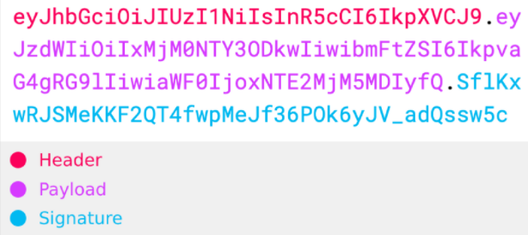
JWT
www.its.ac.id
INSTITUT TEKNOLOGI SEPULUH NOPEMBER, Surabaya - Indonesia

Slide 7
JWT
Header
Contain metadata information
Algorithm → algorithm to sign the token
Type → type of the token (in this case JWT)
Payload
Contains the claim (user information or metadata)
Usually contains identification information about a given user
In general payload can be anything else
There are no restriction on the content of the payload
There are several recommended standard fields in JWT standard
NOTE: the JWT is not encrypted, decodable by anyone https://jwt.io/
www.its.ac.id
INSTITUT TEKNOLOGI SEPULUH NOPEMBER, Surabaya - Indonesia

Slide 8
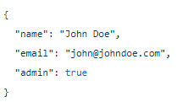
JWT
Example of payload
www.its.ac.id
INSTITUT TEKNOLOGI SEPULUH NOPEMBER, Surabaya - Indonesia

Slide 9
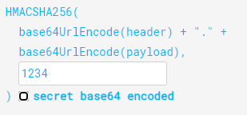
JWT
Signature
Ensure that the message was not change or modified along the way
Verify the sender
Signature is created by combining header, payload and a secret (HMAC-SHA256)
https://www.devglan.com/online-tools/hmac-sha256-online
www.its.ac.id
INSTITUT TEKNOLOGI SEPULUH NOPEMBER, Surabaya - Indonesia

Slide 10
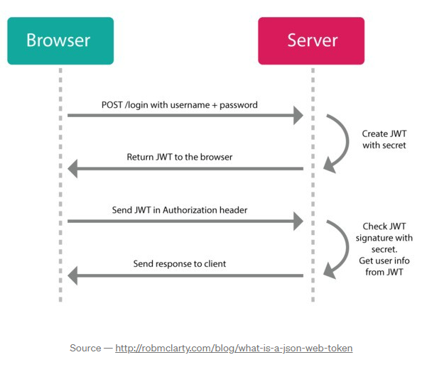
JWT
Step by step JWT
The client send login credential (username and password)
The server send back the JWT token
The JWT token have to be stored in the local storage
When client wants some data, makes request and put JWT in authorization header
Server verifies the JWT, if success server will send the data back to the client
www.its.ac.id
INSTITUT TEKNOLOGI SEPULUH NOPEMBER, Surabaya - Indonesia

Slide 11
JWT use cases
Authorization
The most common scenario, use as identifier for user
Information exchange
Use to securely transmitting information between parties
www.its.ac.id
INSTITUT TEKNOLOGI SEPULUH NOPEMBER, Surabaya - Indonesia

Slide 12
Getting started with JWT
Install jsonwebtoken
npm install –save jsonwebtoken
www.its.ac.id
INSTITUT TEKNOLOGI SEPULUH NOPEMBER, Surabaya - Indonesia

Slide 13

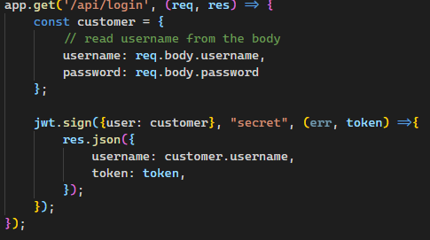
Getting started
Information that we need to send inside the body of the request
Depend on your system requirement
Function to create token using JWT
www.its.ac.id
INSTITUT TEKNOLOGI SEPULUH NOPEMBER, Surabaya - Indonesia

Slide 14
Getting started with JWT
Try it and test the endpoint using Postman
www.its.ac.id
INSTITUT TEKNOLOGI SEPULUH NOPEMBER, Surabaya - Indonesia

Slide 15
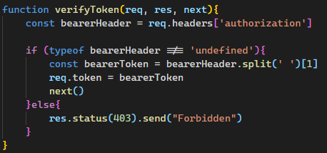
Adding verification
Create verification function
www.its.ac.id
INSTITUT TEKNOLOGI SEPULUH NOPEMBER, Surabaya - Indonesia

Slide 16
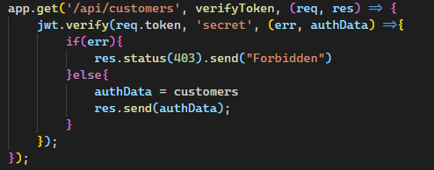
Verification
Modify your code from previous course
www.its.ac.id
INSTITUT TEKNOLOGI SEPULUH NOPEMBER, Surabaya - Indonesia

Slide 17
Getting started with JWT
Try it and test the endpoint using Postman
www.its.ac.id
INSTITUT TEKNOLOGI SEPULUH NOPEMBER, Surabaya - Indonesia

Slide 18
TERIMA KASIH

